Slide 1
Machine Learning Overview

Slide 2
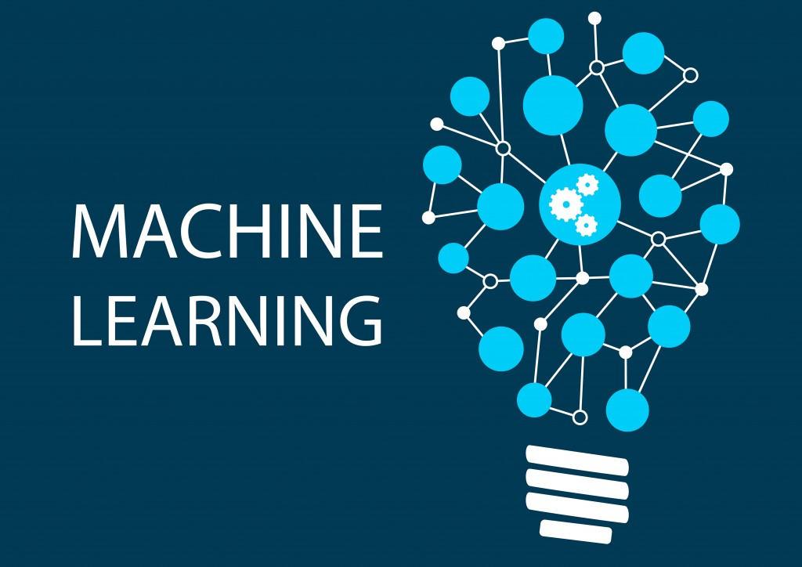
What is Machine Learning?
ML – the ability to learn and improve without explicitly being programmed

Slide 3
Supervised Learning
Linear Regression
Decision Trees
K-Nearest Neighbor
Logistic Regression
Support Vector Machines
Neural Nets
set of data with correct answers
Machine Learning (ML)
Unsupervised Learning
set of data with no answers
Clustering : K-Means
Reinforcement Learning (RL)
a model acts on the environment and gets feedback
Q-Learning

Slide 4
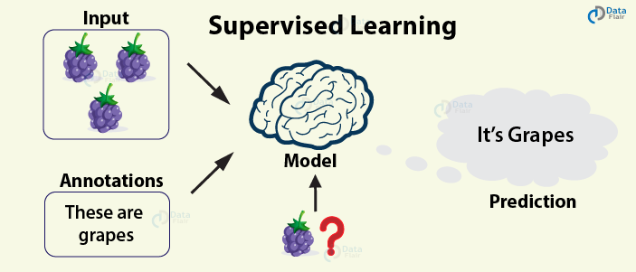
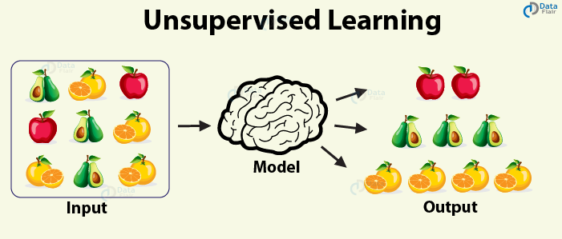
Classical Machine Learning
Explores the data and comes up with the different data categories

Slide 5
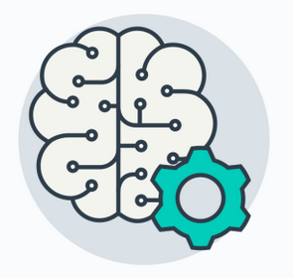
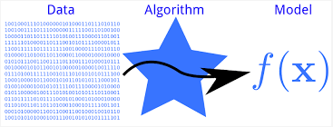
Models
A model is a specification of a mathematical (usually probabilistic) relationship that exists between different variables.
In ML our models are learned from the data
Our task is to select a model based on:
supervised or unsupervised data
the data format (numeric, categories, boolean values)
the kind of output we want (numeric, true/false, probability)

Slide 6
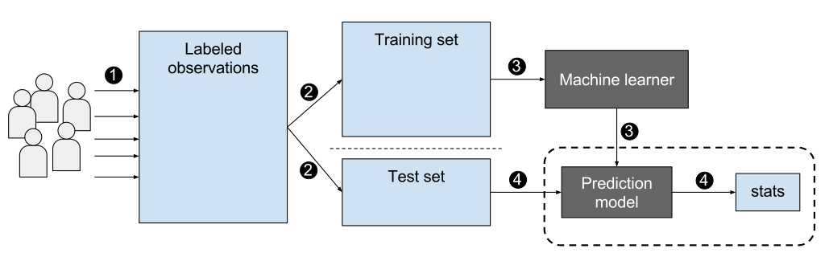
Validating Our Supervised Learning Models

Slide 7
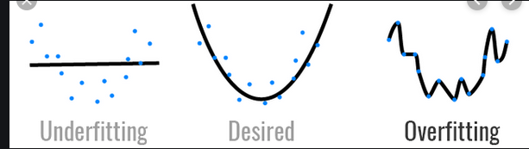
Model Problems: Overfitting and Underfitting

Slide 8
Supervised Machine Learning

Slide 9
Supervised Learning Techniques
Linear Regression
Logistic Regression
Decision Trees
K-Nearest Neighbor
Support Vector Machines
Neural Networks

Slide 10
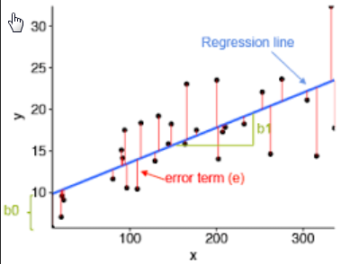
Supervised Learning Techniques
Linear Regression
Logistic Regression
Decision Trees
K-Nearest Neighbor
Support Vector Machines
Neural Networks
Compute a line (y = mx + b) such that you get the best fit for all data points

Slide 11
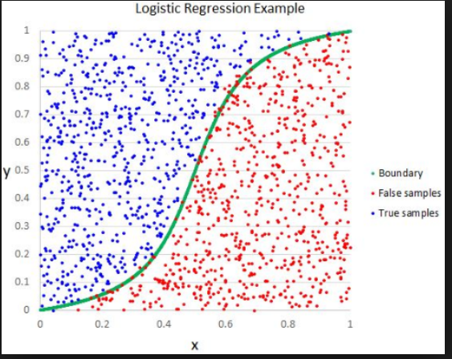
Supervised Learning Techniques
Linear Regression
Logistic Regression
Decision Trees
K-Nearest Neighbor
Support Vector Machines
Neural Networks
Used to predict categories not values

Slide 12
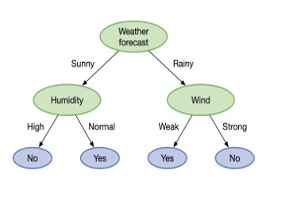
Supervised Learning Techniques
Linear Regression
Logistic Regression
Decision Trees
K-Nearest Neighbor
Support Vector Machines
Neural Networks
Should I go out and play golf?
Should we expect a Cyber attack?

Slide 13
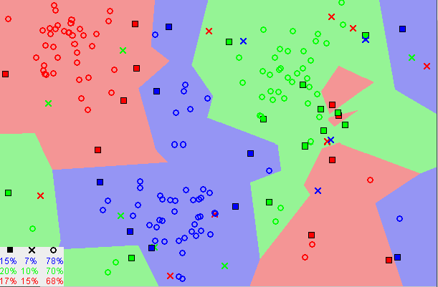
Supervised Learning Techniques
Linear Regression
Logistic Regression
Decision Trees
K-Nearest Neighbor
Support Vector Machines
Neural Networks
The k-nearest neighbors algorithm is a supervised classification algorithm. It takes labeled points and learns how to label other points. ... It is supervised because you are trying to classify a point based on the known classification of other points

Slide 14
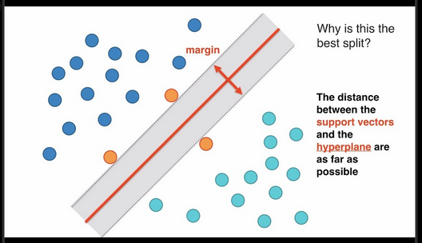
Supervised Learning Techniques
Linear Regression
Logistic Regression
Decision Trees
K-Nearest Neighbor
Support Vector Machines
Neural Networks
SVMs divide data into groups by creating Hyperplanes in multi-dimensional space that separate the groups

Slide 15

Supervised Learning Techniques
Linear Regression
Logistic Regression
Decision Trees
K-Nearest Neighbor
Support Vector Machines
Neural Networks

Slide 16
The hidden layers have weights that control the contribution of input data as the NN tries to learn. The weights will change as the data flow thru the network.
How are the weights adjusted?

Slide 17
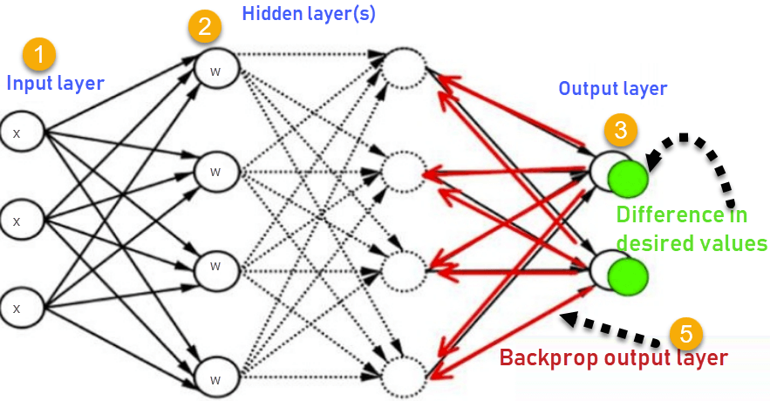
Backpropagation
Backpropagation is an algorithm used to calculate derivatives quickly. Artificial neural networks use backpropagation as a learning algorithm to compute a gradient descent with respect to weights. ... The algorithm gets its name because the weights are updated backwards, from output towards input.

Slide 18
Unsupervised Learning and Reinforcement Learning

Slide 19
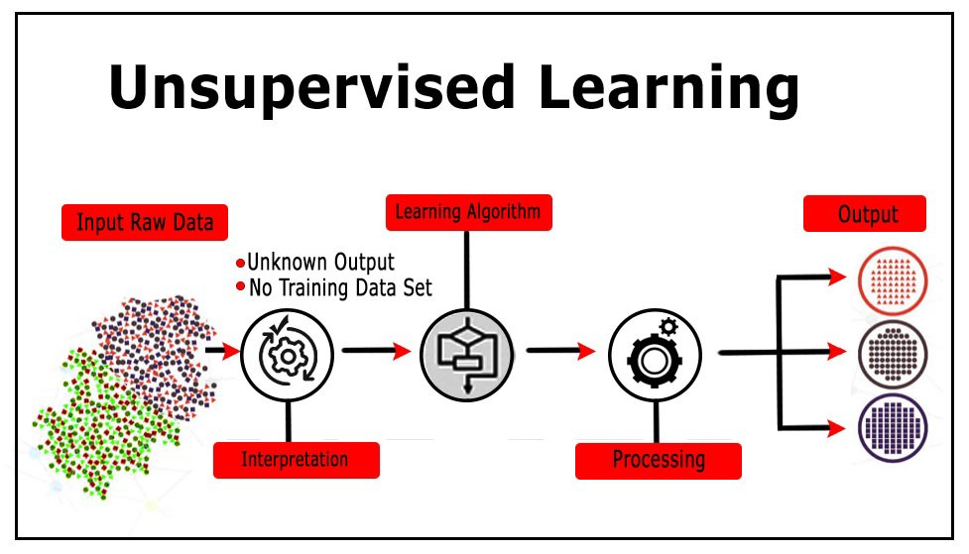
Unsupervised learning
Unsupervised learning is a type of machine learning algorithm used to draw inferences from datasets consisting of input data without labeled responses.
The most common unsupervised learning method is cluster analysis, which is used for exploratory data analysis to find hidden patterns or grouping in data.

Slide 20
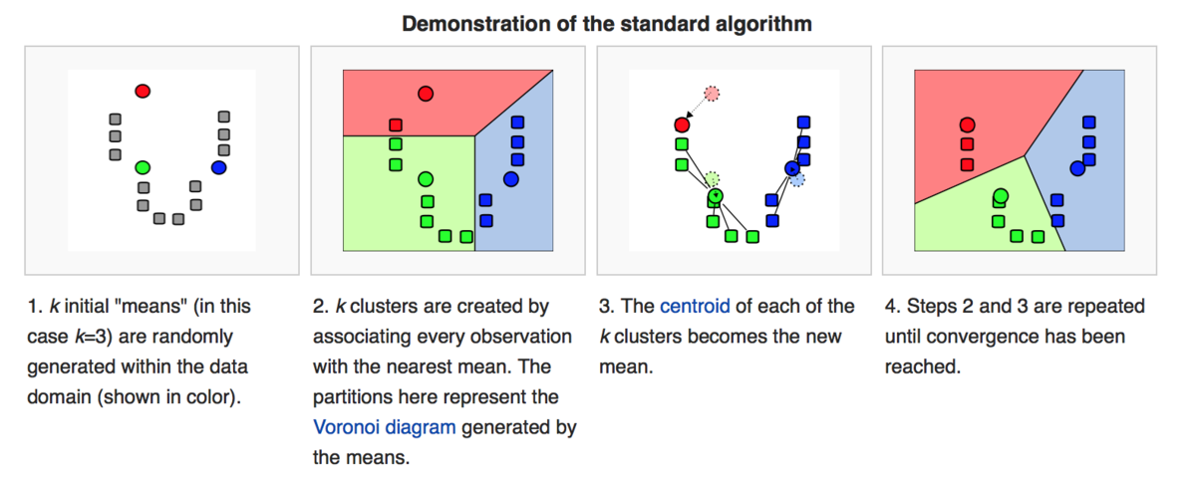
K-Means Clustering

Slide 21
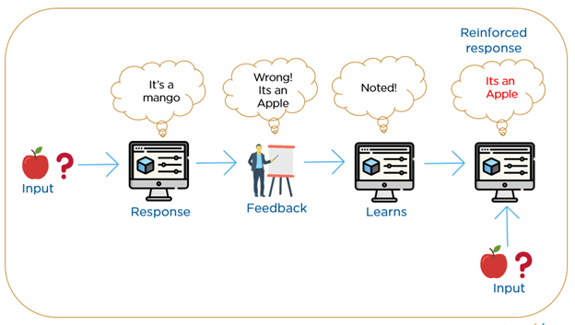
Reinforcement Learning
Reinforcement Learning(RL) is a type of machine learning technique that enables an agent to learn in an interactive environment by trial and error using feedback from its own actions and experiences.

Slide 22
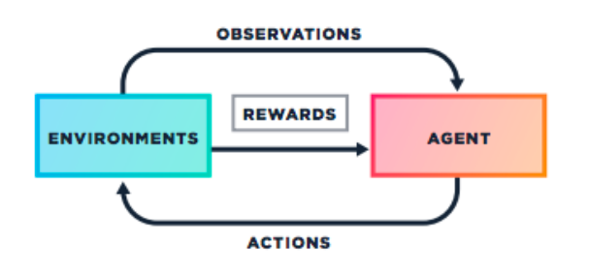
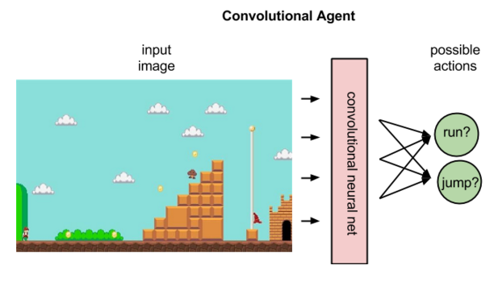
Reinforcement Learning in Games

Slide 23
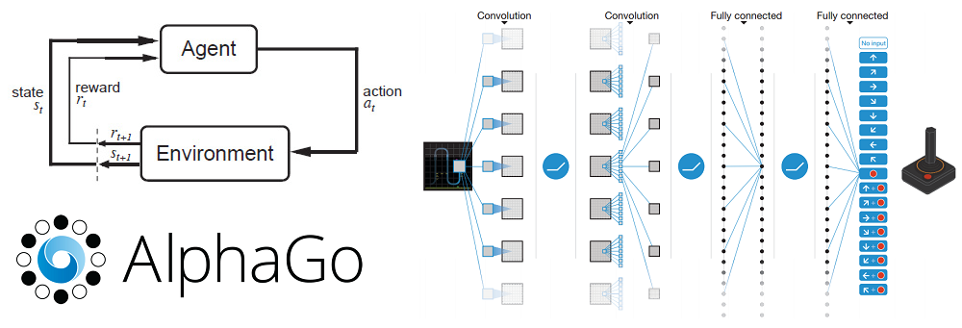

Slide 24
Summary

Slide 25
Summary
Machine Learning is a term that covers a wide range of techniques that fall into three main categories
Supervised Learning
data with known results are used to create a Model
Regression, Decision Trees, SVMs, K-Nearest Neighbor
Unsupervised Learning
data is fed and the system tries to find commonalities
Cluster analysis; K-Means
Reinforcement Learning
Here's an environment. Take action. If you mess up you die. If you achieve a goal, you get rewarded. Do it a few million times. Try not to die. Try and collect rewards.

Slide 26
Readings:
Wikipedia History of AI https://en.wikipedia.org/wiki/History_of_artificial_intelligence
Wikipedia Machine Learning
https://en.wikipedia.org/wiki/Machine_learning
Wikipedia Neural Networks
https://en.wikipedia.org/wiki/Neural_network

Slide 27
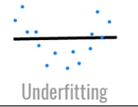
The Bias-Variance Tradeoff
Both are measures of what would happen if you were to train your model on different training sets (from the same general population)
This degree 0 model (e.g. y = 5) takes the average Y value as its predicted value.
The error will be roughly the same for any set of training data from the same population – we say it has HIGH BIAS -- biased toward its simple linear model).
If we compare the models from two randomly chosen training sets we find that the models will be VERY similar.
We say the model has low variance since the models we create will be very similar and not vary very much.

Slide 28
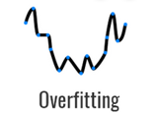
The Bias-Variance Tradeoff
Both are measures of what would happen if you were to train your model on different training sets (from the same general population)
This 15 degree complex model builds a complex polynomial that matches every data item exactly.
– we say it has LOW BIAS
BUT it will have HIGH Variance since any two training sets will give very different curves.

Slide 29
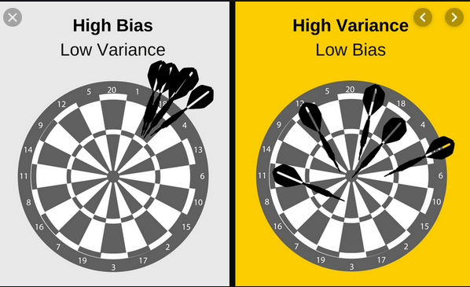
Model Design
If your model has HIGH BIAS – performs poorly on training data you can add more features
If your model has variance you can remove features (you may have features that have no effect and are just adding noise to your model)

